Slide 1


Welcome to RES 2021
RES, Lecture 00
Olivier Liechti
Juergen Ehrensberger
Miguel Santamaria
Daniel Palumbo
James Smith
https://github.com/wasadigi
https://github.com/jehrensb
https://github.com/edri
https://github.com/danpa32
https://github.com/swerky

Slide 2
Agenda
Background
Who are we?
What do we do at the HEIG-VD and why?
Course objectives
Network programming
Application-level protocols
Web infrastructures
Tools
Crash course on Git & GitHub

Slide 3

Background

Slide 4
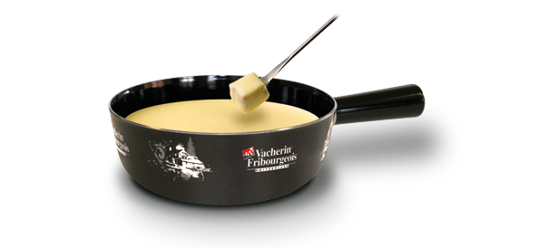



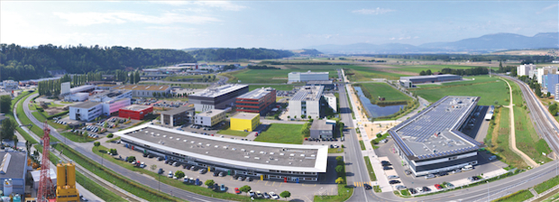



Personal background (Olivier Liechti)

Slide 5

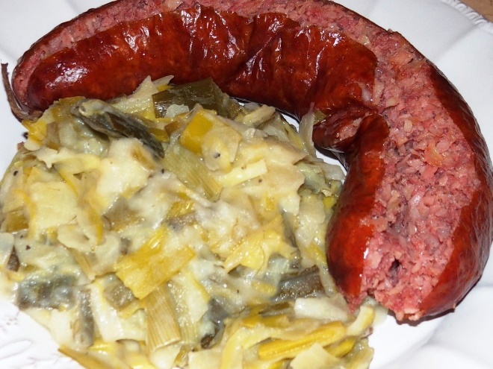


Personal background (J. Ehrensberger)

Slide 6

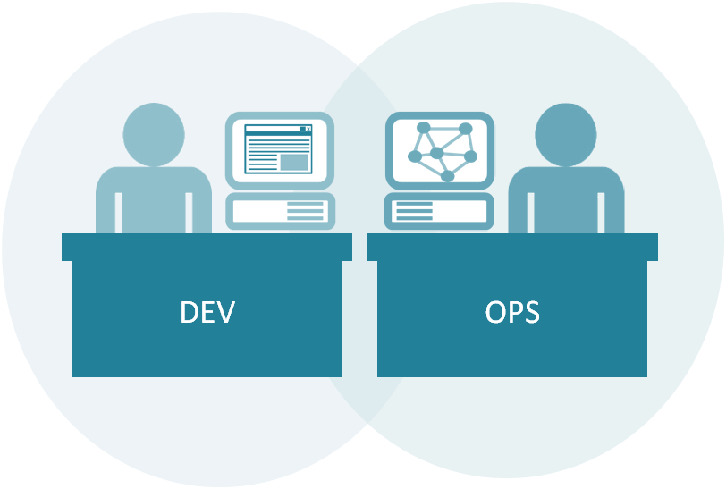

Personal background

Slide 7





R&D at HEIG-VD

Slide 8










Startups

Slide 9
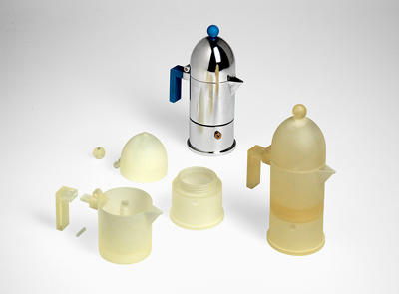


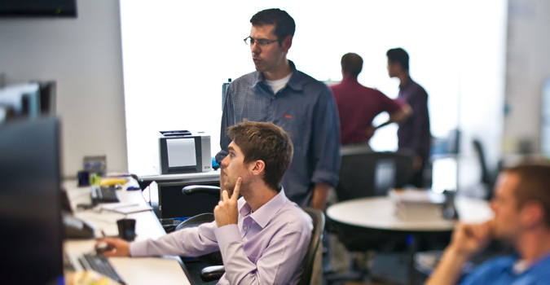


Why do we do applied research?

Slide 10
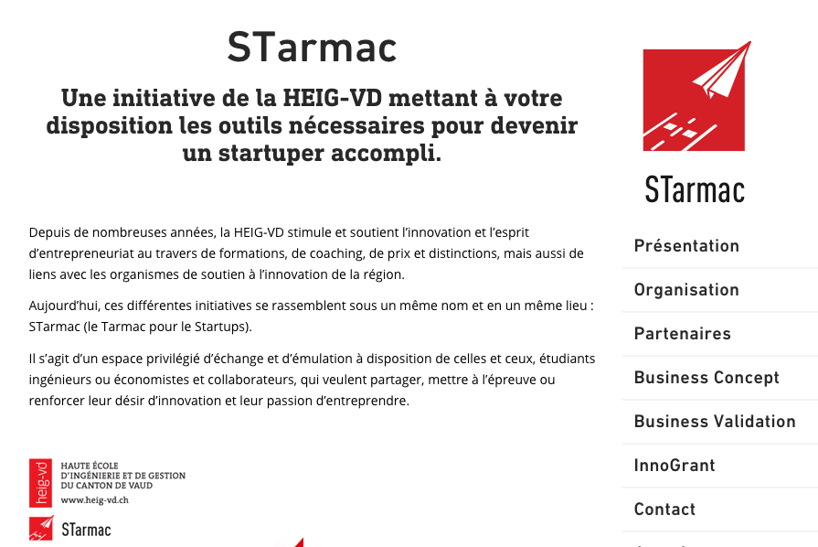
There are plenty of opportunities!

Slide 11

Course Objectives

Slide 12










PDG
4
IL
RES
2 + 2
AMT
3 + 3
IL + TR + TS
TWEB
3 + 3
IL + TS

Slide 13
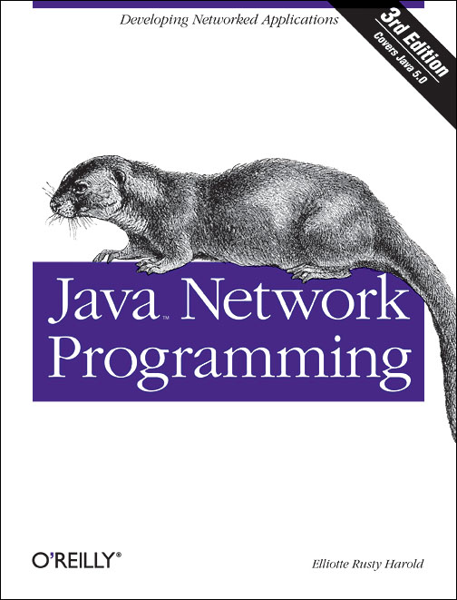
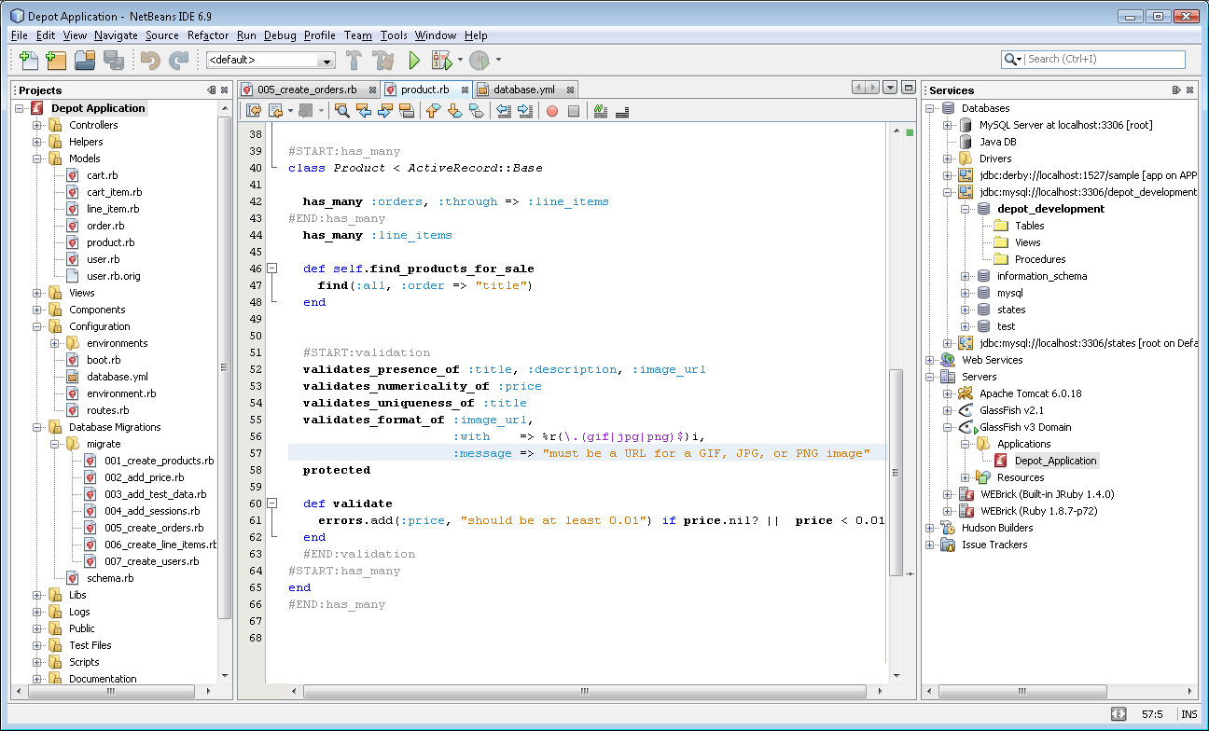
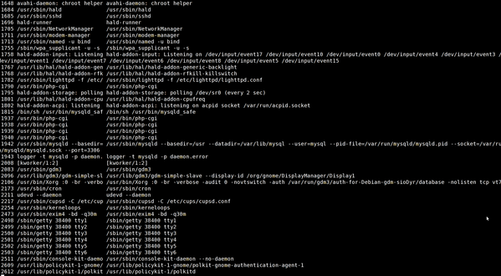


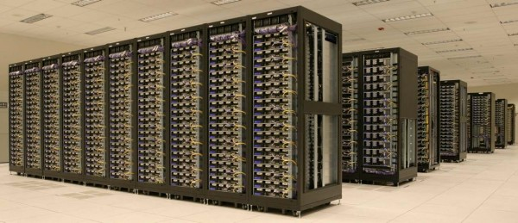




Slide 14
High-level planning
IO programming in Java (starting with files, encodings, etc.)
Network programming in Java (and Javascript)
How do we write TCP clients and servers?
How do we use UDP in our own programs?
The SMTP protocol
The HTTP protocol
Model, syntax, mechanisms
Design and implementation of web infrastructures
Servers, proxies, reverse proxies, load balancers
Building a data center on your laptop with Docker
(Managing user identities with LDAP...)

Slide 15
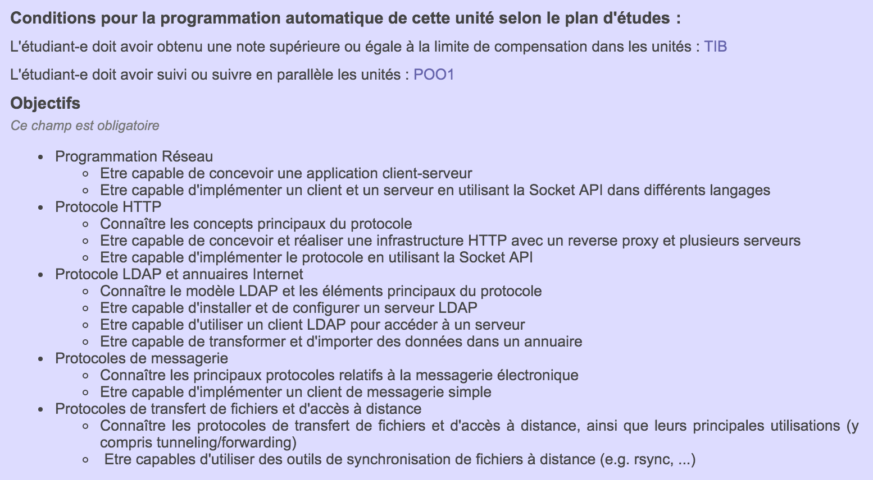
GAPS: plan d’études

Slide 16
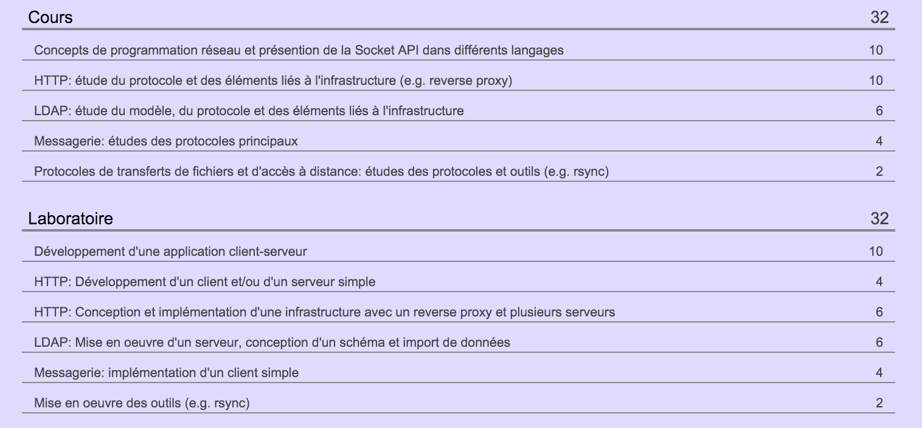
GAPS: plan d’études

Slide 17
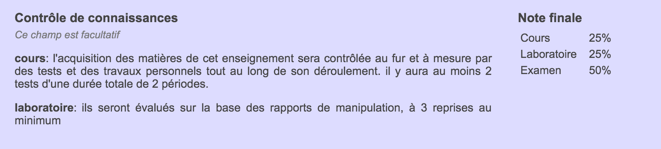
Evaluation
On a regular basis, I will ask you to complete short assignments (quizz, small exercise, single development question, etc.). Often, the assignment will need to be completed during the class or the lab session!
Note on labs: sometimes, we will do a test after the handout to check that everyone in the group worked on assignment.
Pay attention to the “RES 2021 - Annonces” Telegram channel.
At the end of the semester, we will do a BIG lab (http infrastructure). It will have a heavy weight in the lab grade.

Slide 18
Do not forget there is an exam
Do not forget there are lecture notes

Slide 19
Deadlines are ridiculously strictly enforced
We will not look at assignments late by 1’
Do not blame the infra

Slide 20
How not to get lost…

Slide 21




How not to get lost…
Tool which will be used in the course
Teams: for live lectures and labs (introduction, personal discussion)
Telegram: discussions related to the labs: questions, problems, … Shared with the other class.
GitHub : all labs use GitHub. The course material is on GitHub. You will need a GitHub account.
YouTube: for most lab sessions, there are videos on YouTube, made by Olivier Liechti (Playlist RES 2020) https://www.youtube.com/playlist?list=PLfKkysTy70QaSEH6AqwIzVqHJKId73sqR
Course material (slides, lecture notes, examples) https://github.com/jehrensb/Teaching-HEIGVD-RES-2021
Please send a Telegram message to J. Ehrensberger
Please send a mail with your GitHub id to J. Ehrensberger

Slide 22
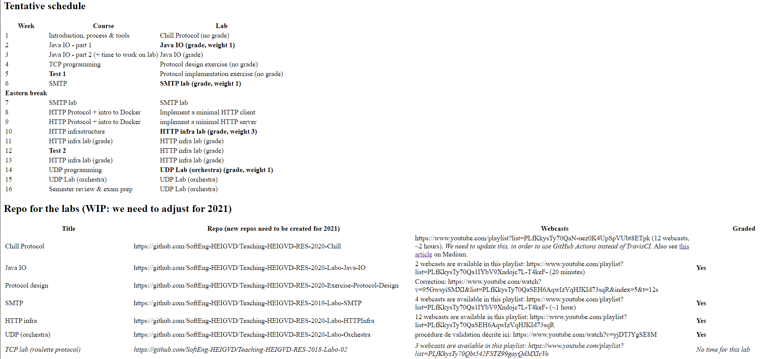
Course program
File Readme.md in course repository

Slide 23

https://github.com/SoftEng-HEIGVD/Teaching-HEIGVD-RES-2021

Slide 25
Telegram etiquette
Understand that this is voluntary, best-effort service.
Understand that we have to deal with scale:
30% of 85 students * 10’ > 4 hours, 10% of 85 students * 30’ > 4 hours
It is not ok to ping Miguel, Daniel and James directly. I have officially forbidden them to respond to DMs (unless it’s to invite them for a beer).
In 95% of the cases, post on the RES 2021 group (there is no stupid question). If the answer is helpful for you, it might be for others. Other students might be faster at answering than us.
For the remaining 5%, ping me (not the animals). Do not hesitate.
“Hello, the second test does not work. Why?” is not an easy question to answer. Where is your code? What have you tried? What was the expected behavior and what do you observe instead?

Slide 26
To do during lab session
Prepare your machine (Git, SSH, Intellij)
Create a GitHub account (send email with GitHub ID to prof)
Install Telegram and create account
Follow https://learngitbranching.js.org/ tutorial (at least the Introduction Sequence – commit, branch, merge, rebase)
Start watching Prelude videos

Slide 27

Tools

Slide 28


Git & GitHub
Step 1: install Git
http://git-scm.com/downloads
http://git-scm.com/book/en/Getting-Started-Installing-Git
Check point: are you able to invoke the git command from the shell?
Step 2: configure Git
https://help.github.com/articles/set-up-git
Step 3: configure SSH
http://guides.beanstalkapp.com/version-control/git-on-windows.html#installing-ssh-keys

Slide 29
Using Git locally
$ mkdir my-project
$ cd my-project
$ git init
$ ls -al
You do not have to use a server: Git is already useful to manage versions of your files on your local machine.
The git init command creates a local repository. If you look carefully, you will see a hidden .git directory, where Git keeps all of his data.
Important: your my-project directory is your working directory. If you simply create files in it, they will not immediately be part of your repository!

Slide 30
Using Git locally
$ echo "text a" > a.txt
$ git status
$ git add a.txt
$ git commit -m “First version of a.txt”
$ echo “my mod on text a” > a.txt
$ git status
A commit is a snapshot of your repository. Git maintains a graph of commits and you can always recover the state of a particular commit.
When you have modified files in your working directory, you need to specify which ones should be part of the next commit.
You use the git add command to add a file to the so-called staging area. It will be part of the next commit.
You use the git status command to check the content of your working directory and of your staging area.
More info: http://git-scm.com/book/en/Git-Basics-Recording-Changes-to-the-Repository

Slide 31
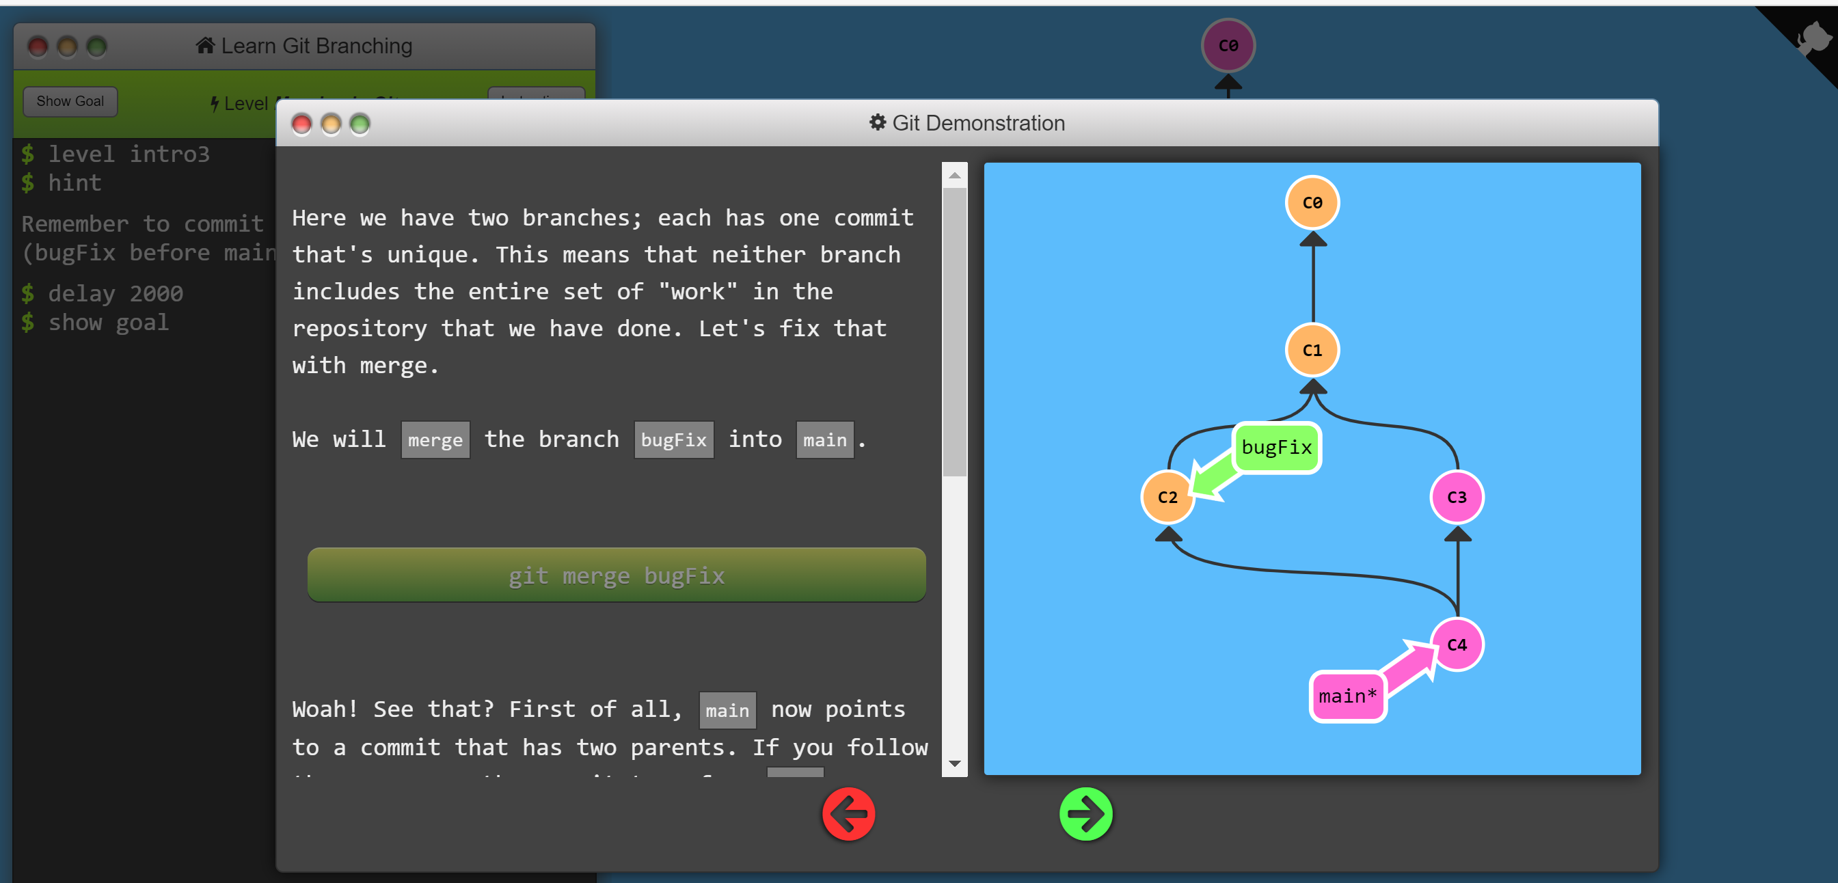
To better understand Git
https://learngitbranching.js.org/
Interactive tutorial to show effect of Git commands

Slide 32
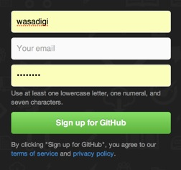
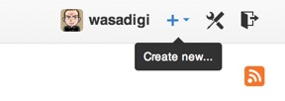
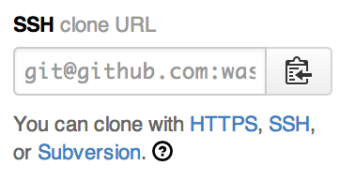
GitHub Setup
Sign up for GitHub and get your own account:
Go to http://www.github.com
Add your SSH key:
Go to your accounts settings. You will find an option to manage your SSH keys.
If you don’t have a SSH key yet, follow the instructions in the online help.
If you are using windows, you will need to use Git BASH.
Create your first repo, hosted on Github.
Copy the SSH URL of the repo.

Slide 33
Validate your setup
Clone your repo to your laptop
Open a terminal window (Terminal on Mac OS, Git BASH on Windows, etc.)
Create a new directory to host your clone of the repo and get into it.
Clone the repo, using the SSH URL.
Create a file, add it to the staging area, commit the changes and finally push the commit Github.
$ mkdir myspace
$ cd myspace
$ git clone git@github.com:UUUUU/RRRRR.git
$ git touch firstFile.txt
$ git add firstFile.txt
$ git commit -m “I have added my first file”
$ git push

Slide 34

https://forms.gle/iZvJngkFoAx7op9f6
10 minutes
Please always use the same Google and GitHub accounts

Slide 35
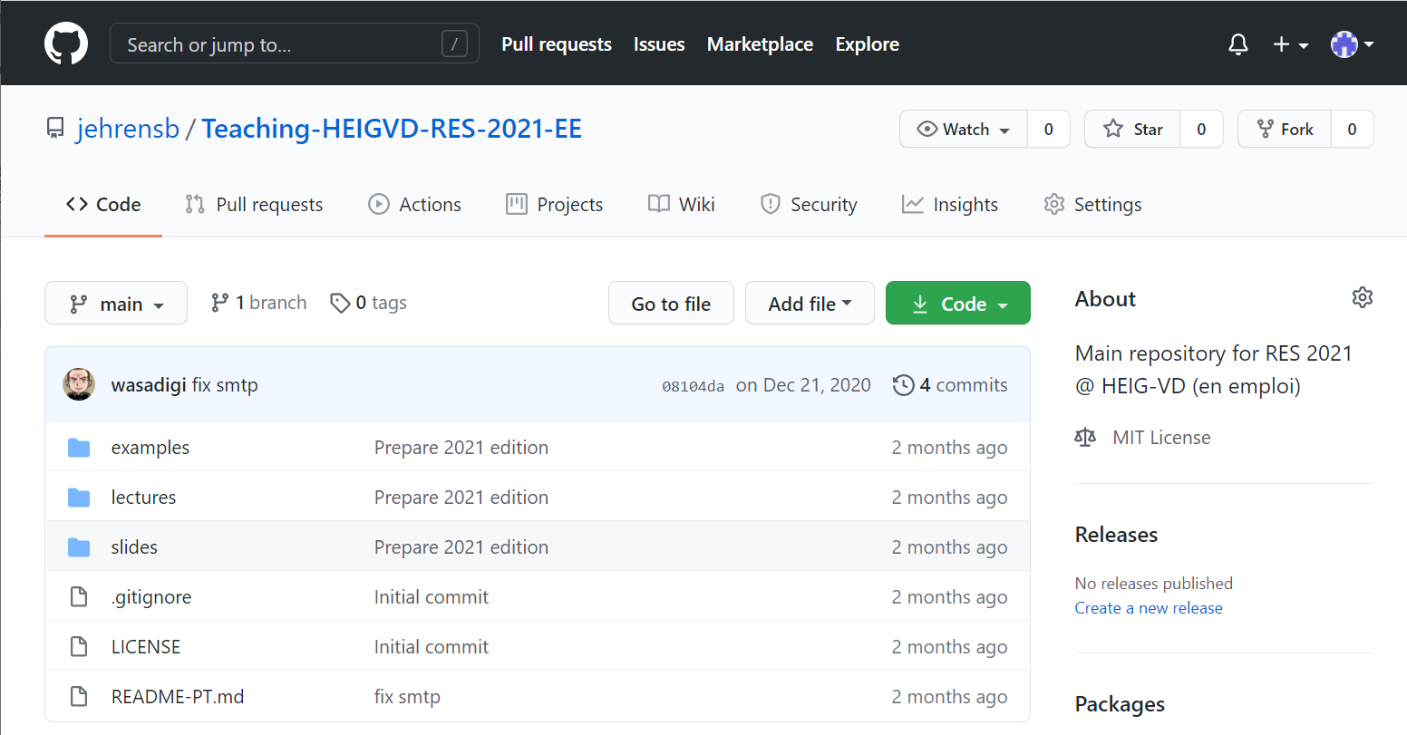
Forks & Clones
If you do this, you will have YOUR clone of MY repo hosted on Github
https://github.com/jehrensb/Teaching-HEIGVD-RES-2021-EE

Slide 36
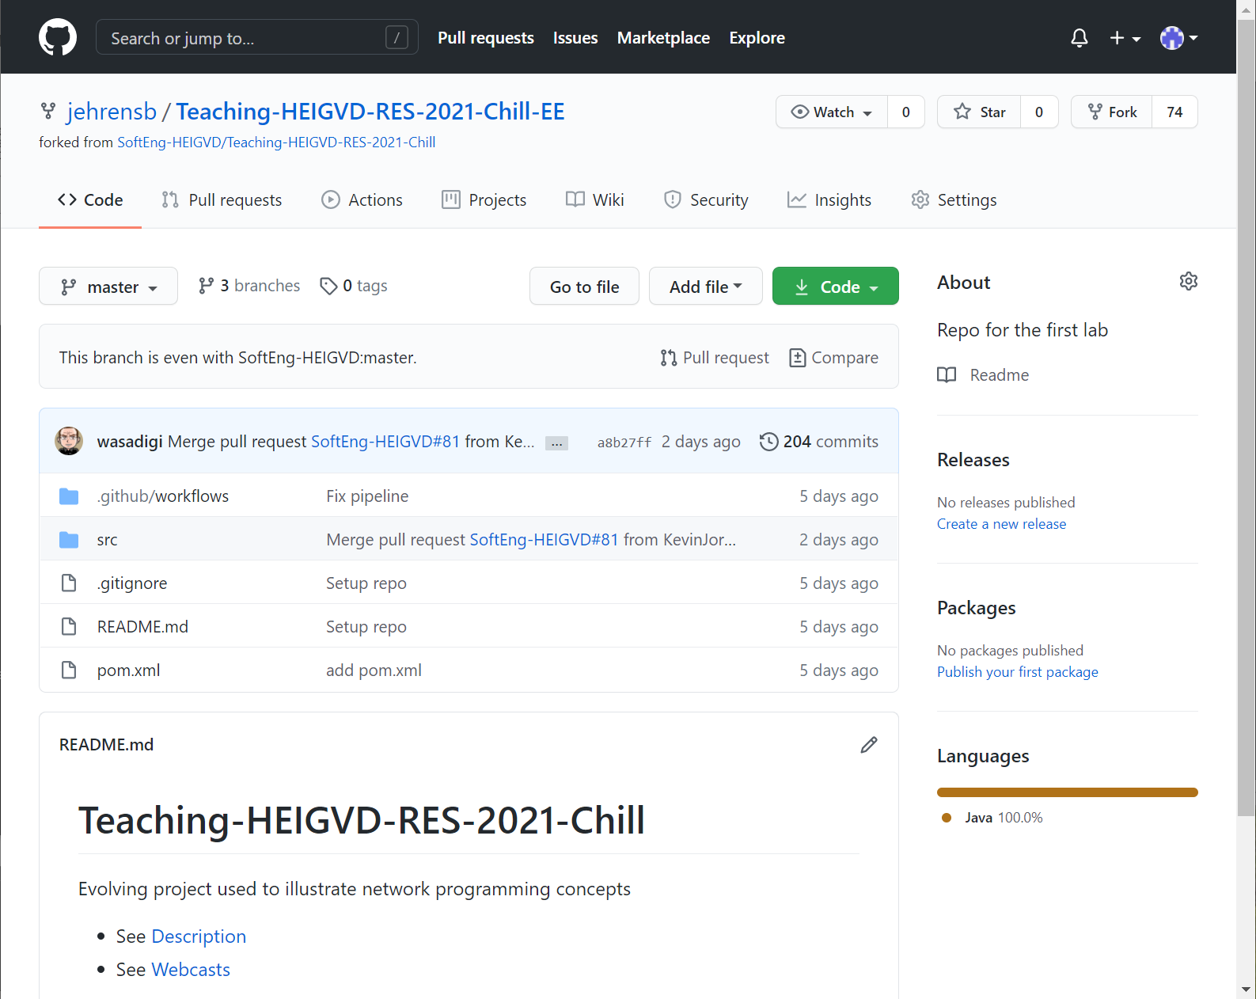
Fork des repos des labos
Exemple: https://github.com/jehrensb/Teaching-HEIGVD-RES-2021-Chill-EE
Vous devez aussi créer un fork des repos des laboratoires
Votre fork peut être privé ou public
NE COPIEZ PAS le code des autres (même classe ou années précédentes)
Vous pouvez discuter les solutions entre vous, mais écrivez votre propre code.
Transmettez votre implémentation au prof par des Pull Requests

Slide 37
Forking My Repo on GitHub
My
Repo
Your
Remote repo
fork
git clone
Bob
Local Repo
Your
Local Repo
Alice
Local Repo

Slide 38
Forking My Repo on GitHub
My
Repo
Your
Remote repo
git push
git pull --rebase
git pull --rebase
Bob
Local Repo
Your
Local Repo
Alice
Local Repo

Slide 39
How Do Will You Get My Updates?
My
Repo
Your
Remote repo
git push
# configuration, do it once
git remote add upstream git://github.com/UU/RR.git
git remote -v
Your
Local Repo
git fetch upstream
git rebase upstream/main

Slide 40
Using Git locally
Git is a "content-addressable file system"
Git uses a key-value store:
When you store a file in a repo, git computes a SHA-1 hash of its content.
The hash is used as a key to index the file in the store.
For this reason, two files with exactly the same content are stored only once in the git repository.
Go in the .git hidden directory, have a look at the ./objects directory and you will find this key-value store.

Slide 41
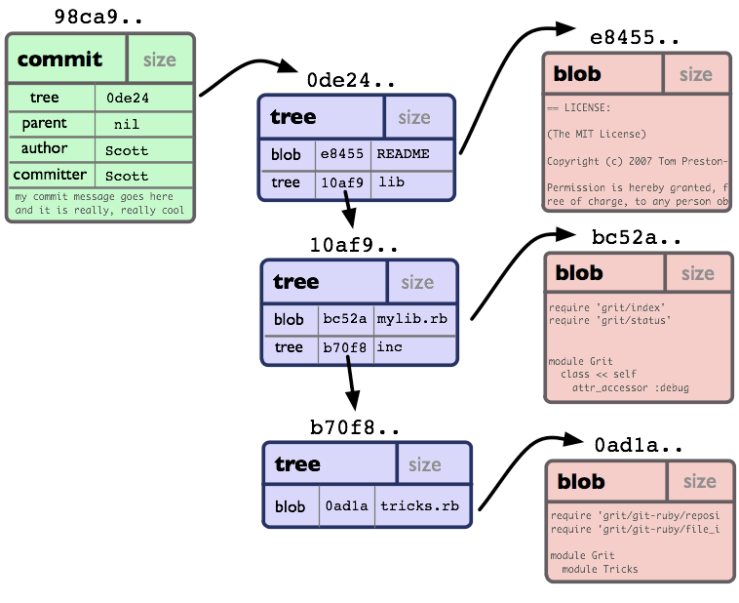
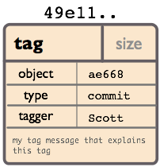
The Git Object Model
BLOBs store files.
Trees store directory structures in the file system. A tree has pointers to subtrees and BLOBs.
Commits identify snapshots in the history. Every commit points to a version of the top-level tree. A commit also stores metadata: author, parent, message, etc.
Annotated Tags (created with git tag -a) are used to mark releases.
Recommendation: do not use lightweight tags (created with git tag, without -a)
http://shafiulazam.com/gitbook/1_the_git_object_model.html

Slide 42
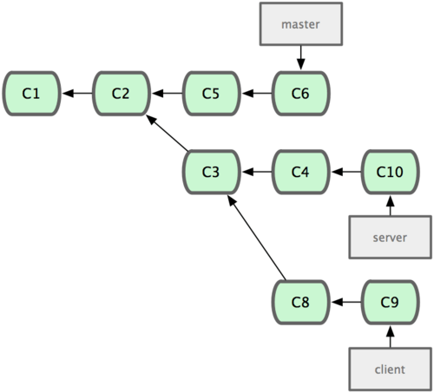
The Git history is a DAG structure
A DAG is a Directed Acyclic Graph
Except for the initial commit, every commit has a least one parent.
Commits with more than one parent are "merge" commits.
In this example:
C1 is the initial commit
There are no merge commits
master, server and client are branches
The branches have never been merged
The last commit on the client branch is C9
All branches have C1 and C2 as common ancestors
http://shafiulazam.com/gitbook/1_the_git_object_model.html

Slide 43
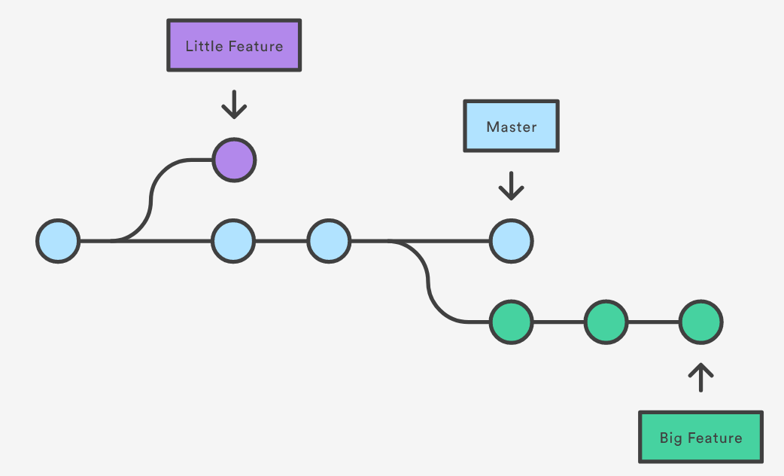
https://www.atlassian.com/git/tutorials/using-branches

Slide 44
Git branches are only pointers
Branches are stored in files located in the .git/refs/heads directory.
Each branch is stored in a file, which only contains the hash of a commit.
What is HEAD?
HEAD means "the tip of the current branch" (last commit of the current branch)
When you checkout a branch, HEAD is the name of this branch.
http://shafiulazam.com/gitbook/1_the_git_object_model.html

Slide 45
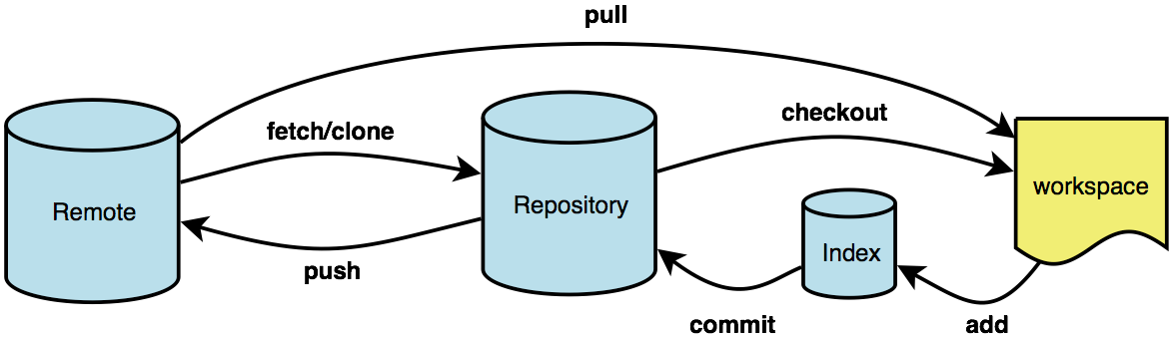
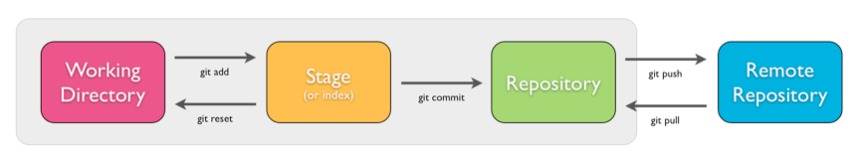
Git & Remote Repositories
Source: http://illustrated-git.readthedocs.org/en/latest/
Source: http://bramus.github.io/ws2-sws-course-materials/xx.git.html#/4/1

Slide 46

Lab Introduction

Slide 47
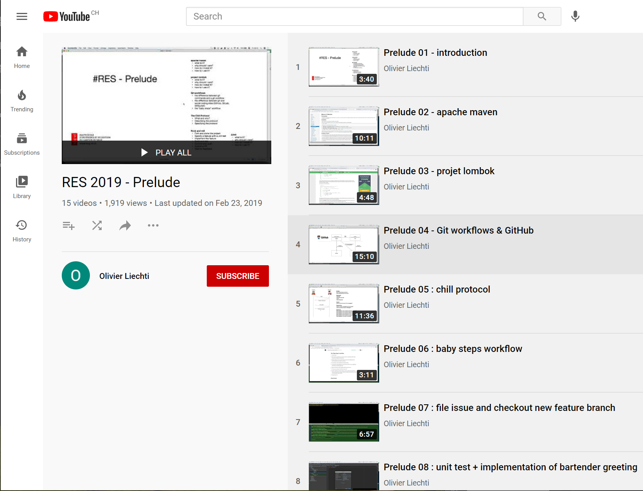
YouTube playlist
RES 2019 - Prelude
https://www.youtube.com/playlist?list=PLfKkysTy70QaN-uez0K4UpSpVUbt8ETpk
12 videos,
about 2 hours!
Commencer avec la video 11

Slide 48
Important points
GitHub workflow (start by forking, not cloning the source repo)
What is maven?
What is project Lombok?
How do we use unit tests to specify behavior?
Where to write your code (NOT in the test package!!!)
What is an application-level protocol and how does not specify one?

Slide 49
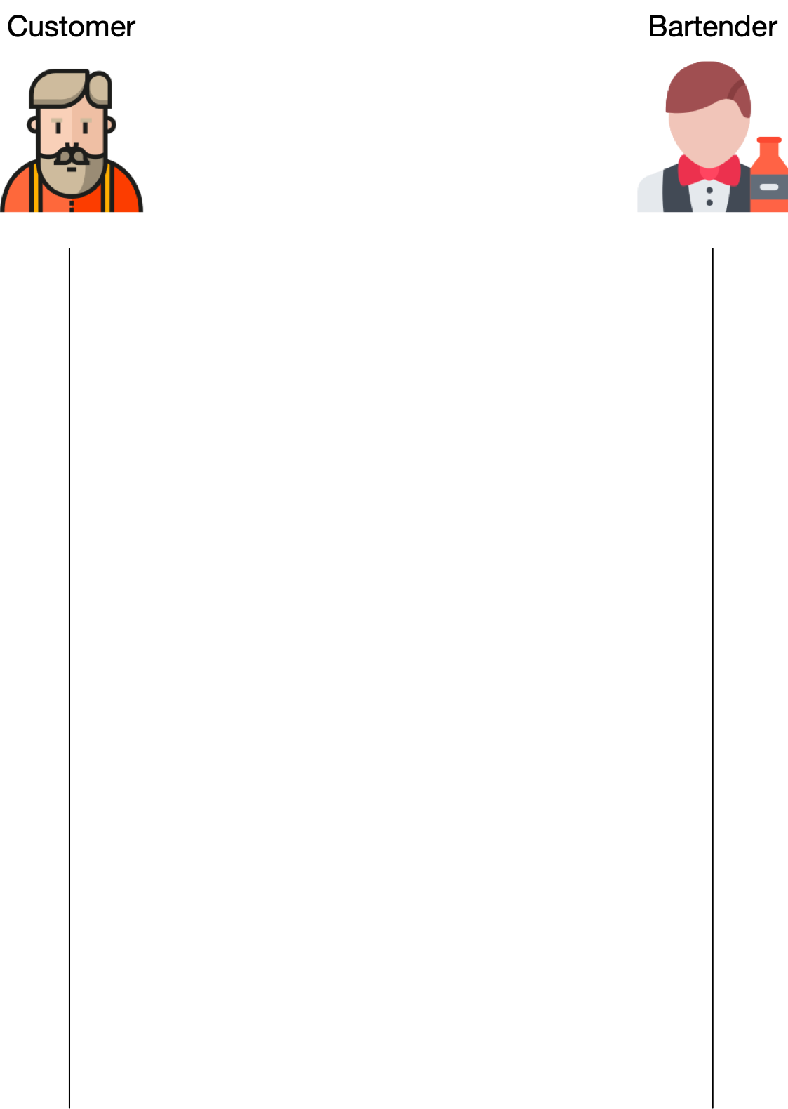
The Chill Protocol

Slide 50

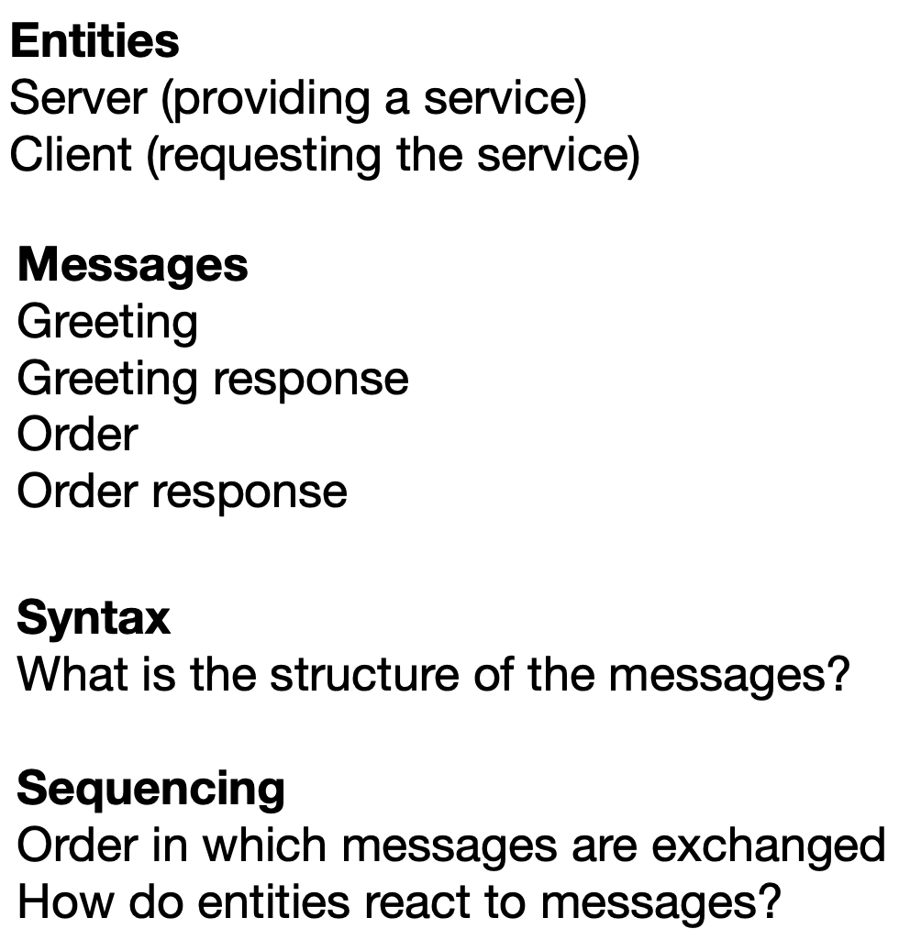
The Chill Protocol

Slide 51
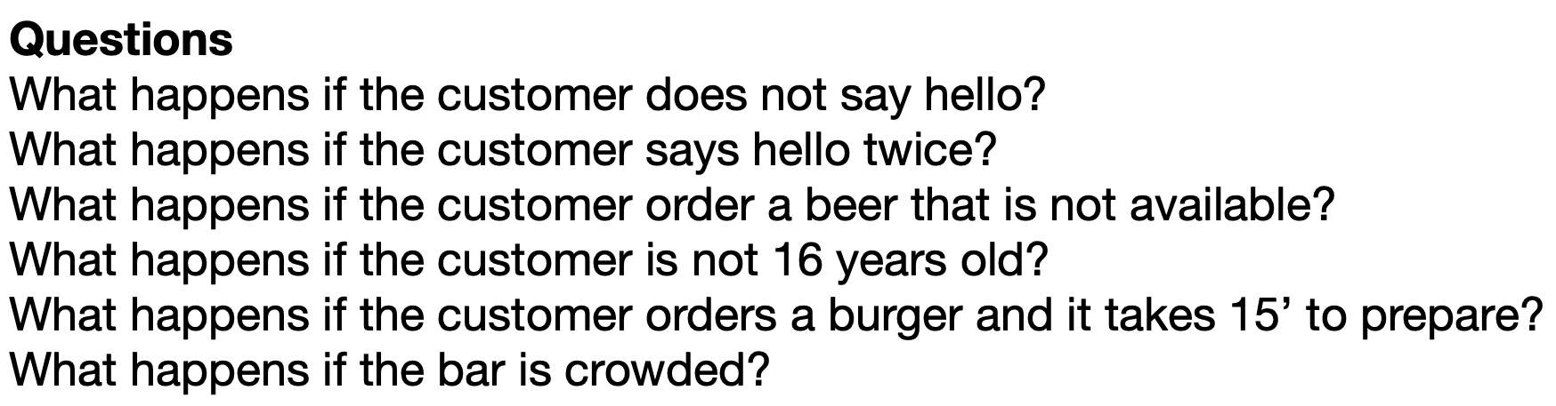
The Chill Protocol

Slide 52
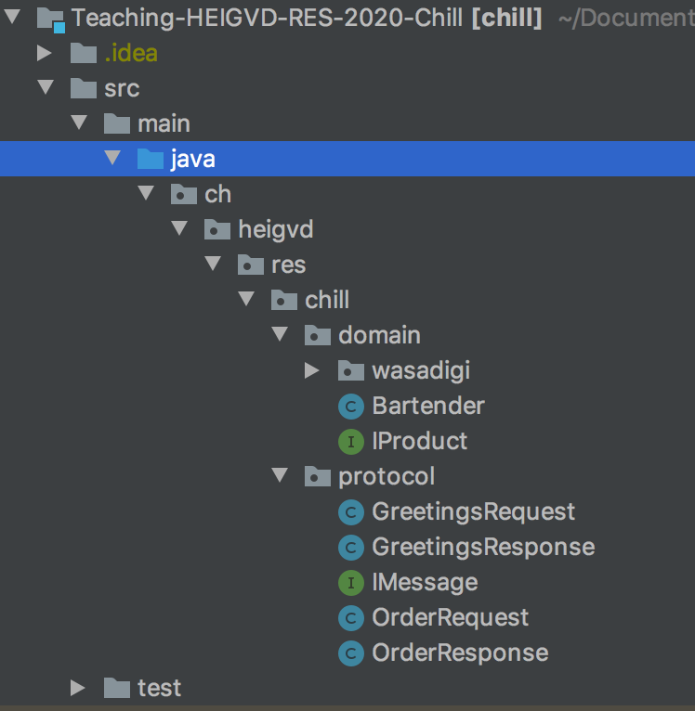
Dans le code
Vous verrez les paquetages de wasadigi sous main/ et sous test/
Créez vous implémentations et tests avec votre nom d’utilisateur Github
Pour chaque sorte de bière, créer deux classes main/…/domain/<user>/Boxer.java test/…/domain/<user>/BoxerTest.java

Slide 53
class BartenderTest {
@Test
void aBartenderShouldReplyToGreetings() {
Bartender john = new Bartender();
GreetingsRequest request = new GreetingsRequest("Hi there");
GreetingsResponse response = john.greet(request);
assertEquals("hello, how can I help you?", response.getText());
}
}

Slide 54
import lombok.Data;
@Data
public class GreetingsRequest implements IMessage {
private final String text;
}

Slide 55
public class Bartender {
public GreetingsResponse greet(GreetingsRequest request) {
return new GreetingsResponse("hello, how can I help you?");
}
public OrderResponse order(OrderRequest request) {
String productName = request.getProductName();
try {
// let Java reflection do its magic
IProduct product = (IProduct) Class.forName(productName).getDeclaredConstructor().newInstance();
BigDecimal totalPrice = product.getPrice().multiply(new BigDecimal(request.getQuantity()));
return new OrderResponse(totalPrice);
} catch (Exception e) {
return null;
}
}
}

